Slide 1
Emotions Recognition Using EEG Signals : A Survey
Soraia M. Alarcao, and Manuel J. Fonseca, Senior Member, IEEE,
Review
12191682 진태균

Slide 2
Motivation
In past, Emotions have been largely ignored, in particular in the field of Human-Computer Interaction(HCI).
Affective Computing has emerged to fulfill this gap by converging technology and emotions into HCI.
In this paper, there are two different perspectives:
1. a set of recommendations to avoid common pitfalls
2. steps of the process of recognizing emotions from EEG signals

Slide 3
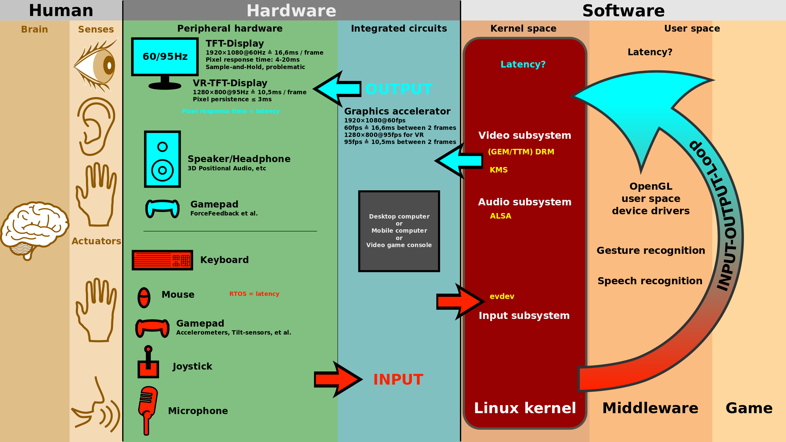
Human-Computer Interaction
HCI is research in the design and the use of computer technology, which focuses on the interfaces between people and computers.

Slide 4
Emotions Recognition
A person’s inner emotional state may become apparent by…
1. how the person feels (subjective experiences)
2. physiological signals (internal expressions)
3. audio, visual signals (external expressions)
Subjective self-reports about how the person is feeling
-> Participants may not answer exactly how they are feeling

Slide 5
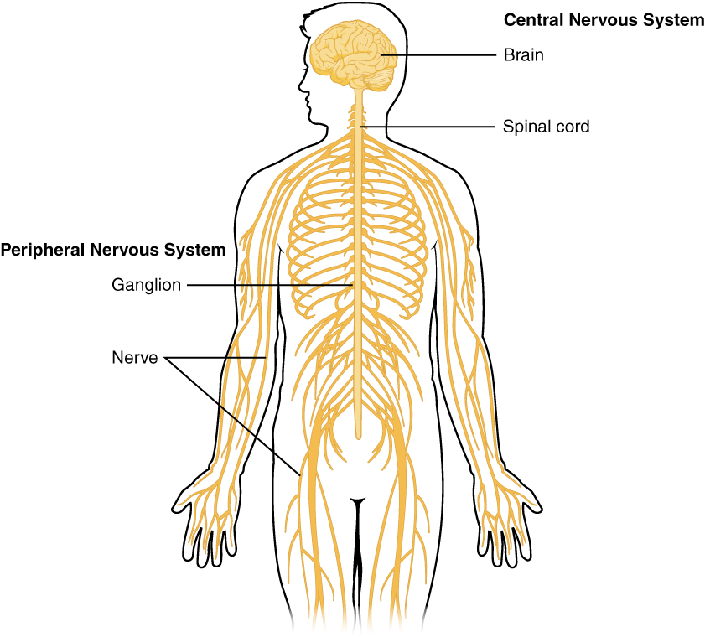
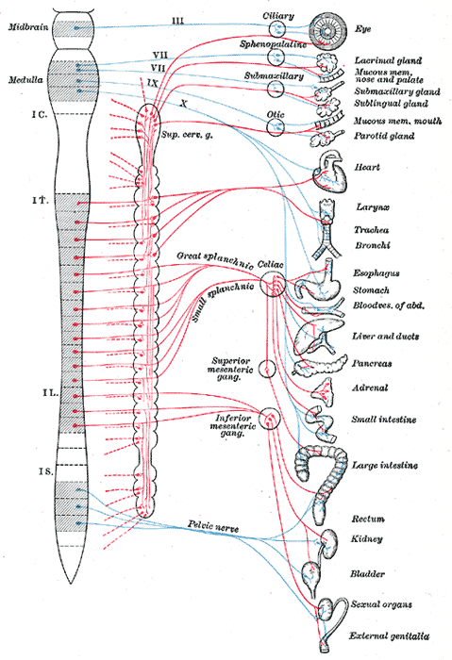
Physiological Signals
Central Nervous System
Autonomic Nervous System

Slide 6
Physiological Signals
Galvanic Skin Response (GSR, 피부전도도)
Electromyography (EMG, 근전도검사)
Heart Rate (HR)
Respiration Rate(RR)
Functional Neuroimaging : for measuring an aspect of brain function
- Electroencephalography (EEG)
- functional Magnetic Resonance Imaging (fMRI)
- Positron Emission Tomography (PET)

Slide 7
Why EEG?
Weakness
1. Poor spatial resolution
2. Needs many electrodes placed at various sites on the head
Strength
1. Great time resolution that allows researchers to study phase changes
in response to emotional stimuli.
2. Noninvasive, Fast, Inexpensive, Wearability, Portability

Slide 8
Methodology
Queries on Google Scholar, Pubmed, and IEEE Xplore
: EEG + Emotions + Recognition and EEG + Emotions + Identification
Papers that published between 2009 and 2016
→ 155 papers
Analyzing the quality of the papers by considering the number of citation : bigger than the median of citations for each year?
→ 88 papers
Analyzing the content and novelty of each of the papers below the threshold → 99 papers

Slide 9
Emotion
A complex psychological state that involves three distinct components :
A subjective experience, A physiological response, and A behavioral or expressive response.
Feelings : a subjective representation of emotions.
Moods : diffuse affective states that generally last for much longer
durations than emotions.
Affect : encompassing term used to describe the topics of emotions,
feelings, and moods all together.

Slide 10
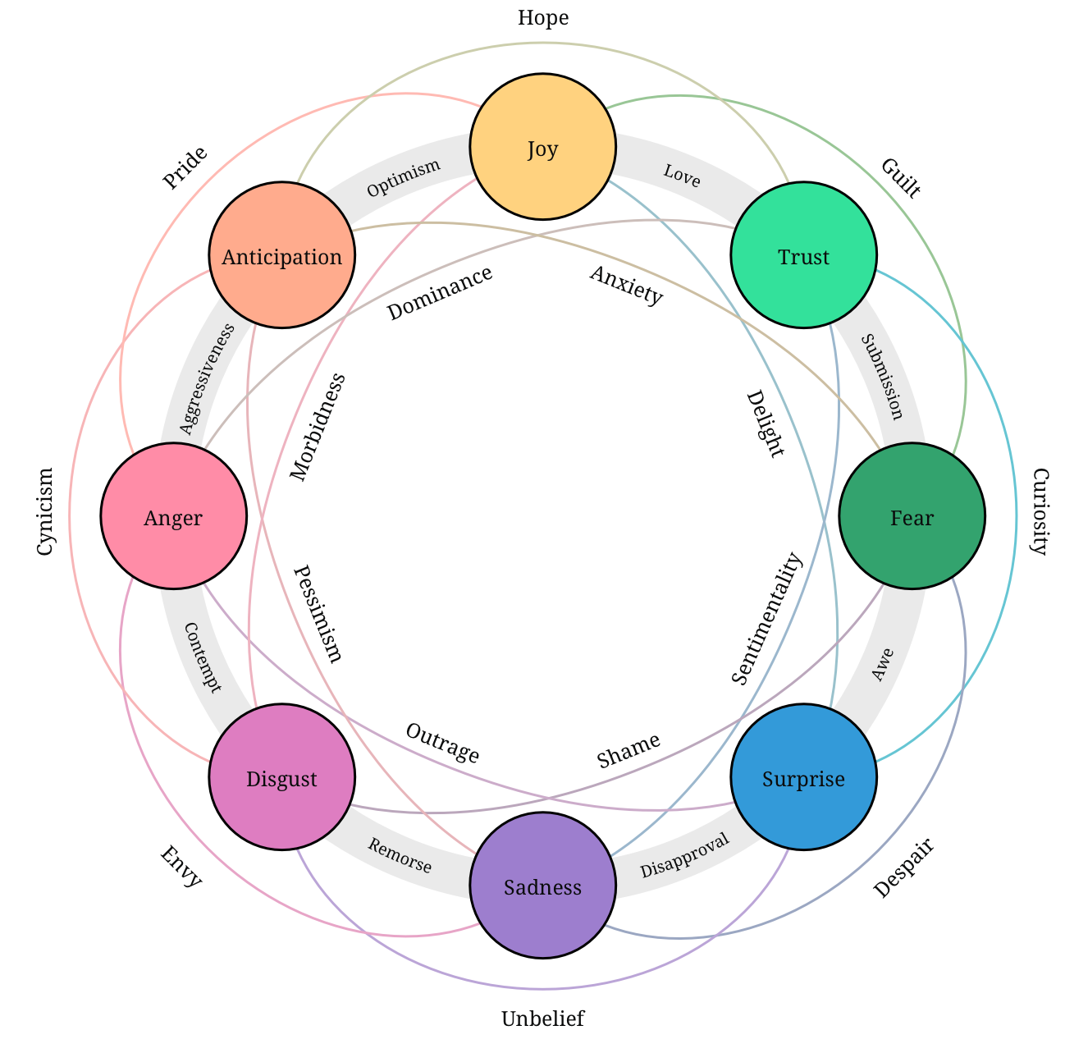
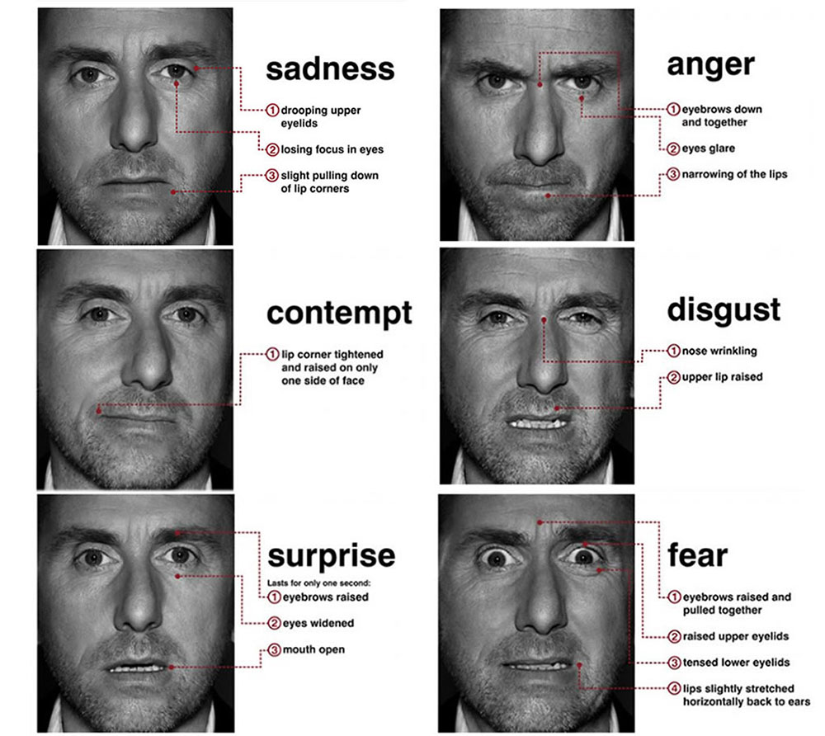
Emotion
have evolved through natural selection.
Plutchik’s Emotion Dyads
Ekman’s Emotion

Slide 11
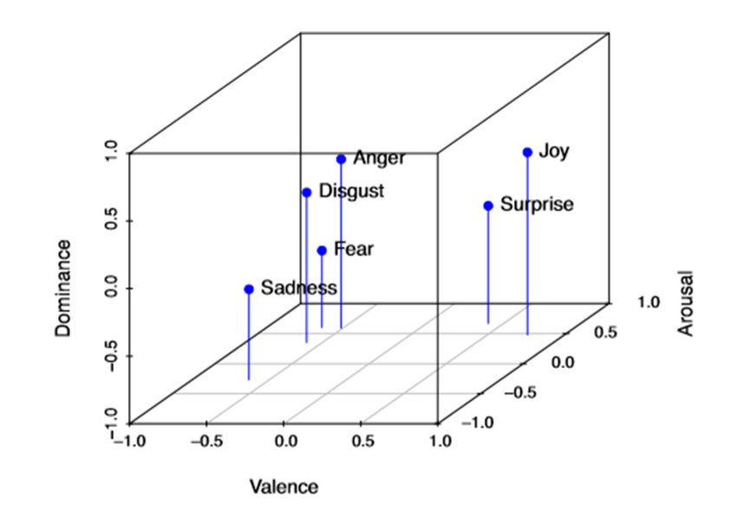
Emotion (VAD)
based on cognition
Valence : from positive feelings to negative feelings
Arousal : from states like sleepy to excited
Dominance : strength of the emotion.

Slide 12
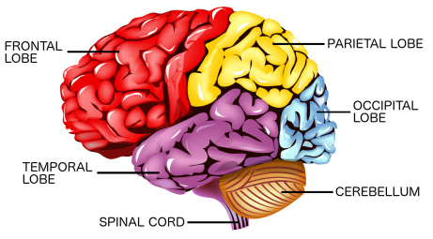
Electroencephalography (EEG)
A medical imaging technique that reads scalp electrical activity generated by brain structures. (typical adult : 10~100μV)

Slide 13
Electroencephalography (EEG)
Frontal lobe : conscious thought
Temporal lobe : the senses of smell and sound, and the processing of
complex stimuli such as faces and scenes
Parietal lobe : integrating sensory information from various senses, as
well as the manipulation of objects
Occipital lobe : sense of sight

Slide 14
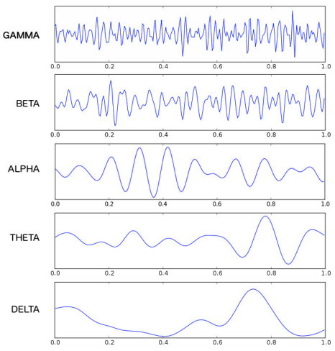
Electroencephalography (EEG)
Gamma(>30Hz) : hyper brain activity
Beta(13~30Hz) : active state of mind, and more prominent in the frontal cortex.
Alpha(8~13Hz) : relaxed mental state, and more visible over the parietal and occipital lobes.
Theta(4~7Hz) : subconscious mind, dreaming
Delta(1~4Hz) : unconscious mind, dreamless sleep

Slide 15
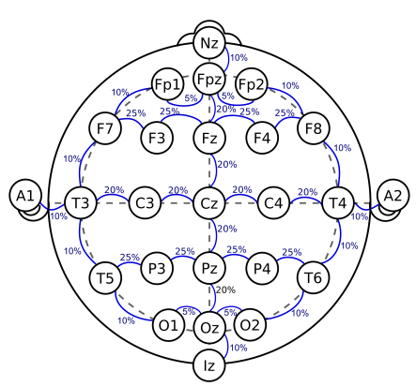
Electroencephalography (EEG)
Electrodes Location
An internationally recognized method to describe and apply the location of scalp electrodes in the context of an EEG.
10% or 20% of the total front-back or right-left distance of the skull.
F : frontal, T : temporal, C : central,
P : parietal, O : occipital

Slide 16
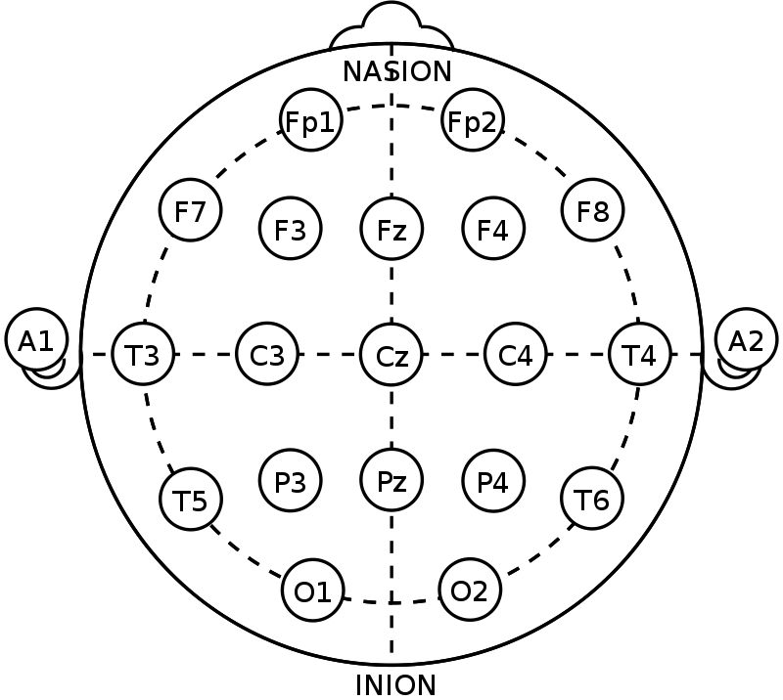
Electroencephalography (EEG)
Electrodes
can be monopolar or bipolar
Monopolar electrodes compared to a neutral electrode connected to an ear lobe or mastoid.
Bipolar electrodes shows the potential difference between two paired electrodes.

Slide 17
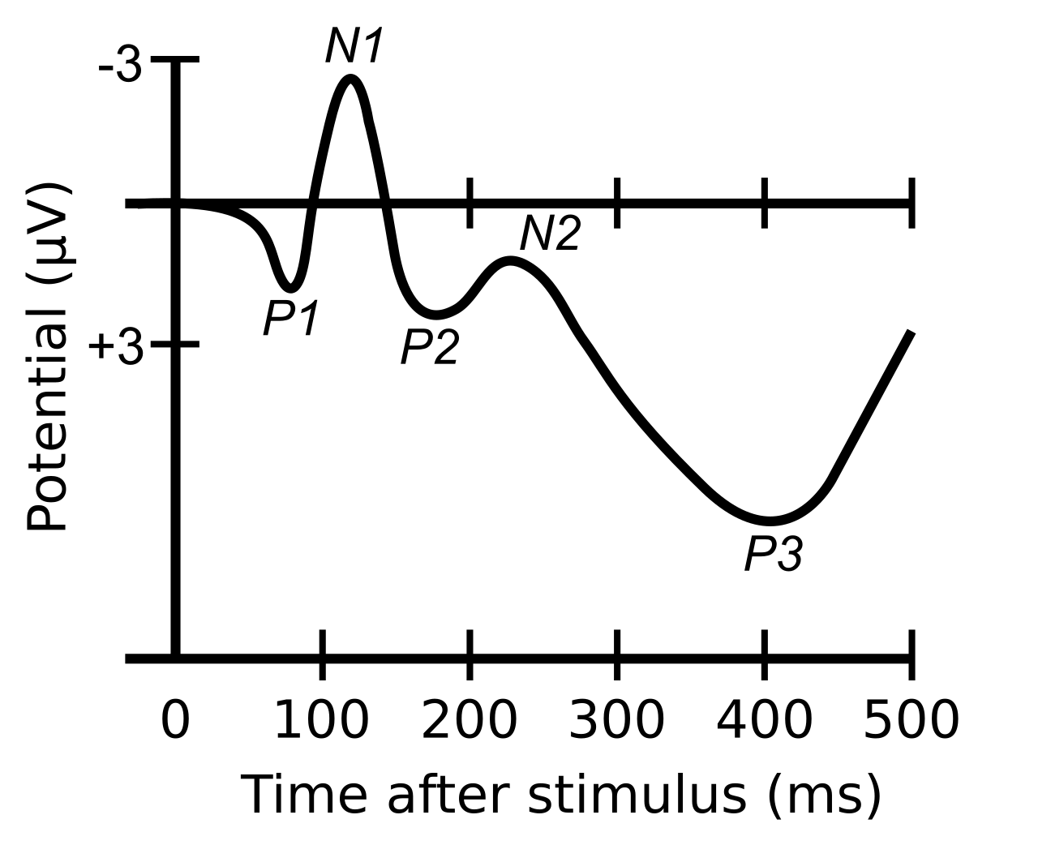
EEG Paradigms
Sensory Evoked Potentials (SEP)
- AEP(Auditory), VEP(Visual), SsEP(Somatosensory)
Event-Related Potentials (ERP)
- have a very high temporal resolution.
- are measured as latencies and amplitudes
of positive and negative potentials at specific
millisecond intervals following a stimulus.

Slide 18
EEG Paradigms
Event-Related Desynchronization/Synchronization
- Evaluation of power changes within specified frequency bands with a high temporal resolution.
ERS : increased power within a frequency band after the presentation of a stimulus
ERD : decreased power within a frequency band after the presentation of a stimulus

Slide 19
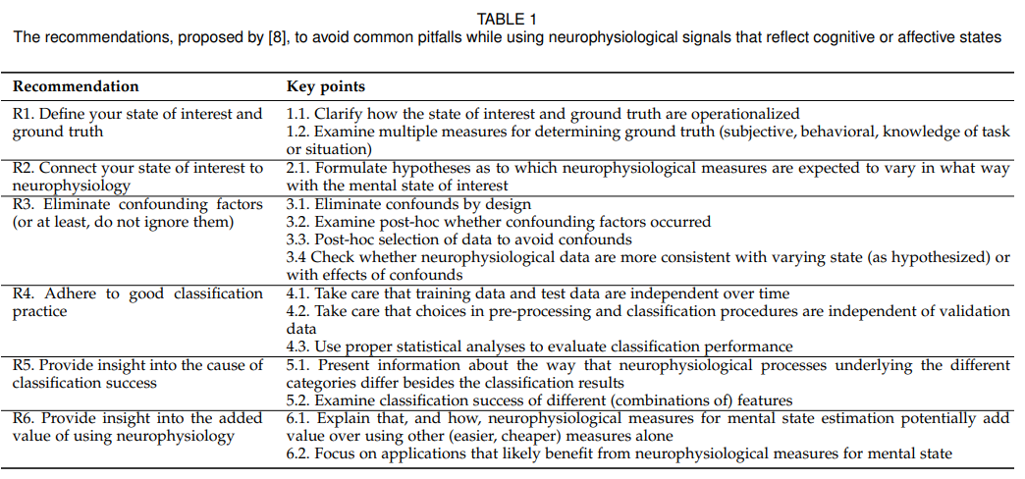
Brouwer’s Recommendations

Slide 20
Brouwer’s Recommendations
R1. Define state of interest and ground truth
- some of the works only collect the signal data, assuming that the stimulus effectively elicited the emotions expected.
R2. Connect state of interest to neurophysiology
R3. Eliminate confounding factors
- should examine the data to verify their existence and to check if the neurophysiological variables vary with the mental state of interest or due to confounds.
R4. Adhere to good classification practice

Slide 21
Brouwer’s Recommendations
R5. Insight into the cause of classification success
- Also important to present information about the way the neurophysiological processes underlying the different features differ.
R6. Added value of using neurophysiology
For what?
- future works should provide more information about how the EEG signals vary
depending on the state of interest.
- Researcher should present the advantages of using EEG signals over other physiological
measures.
- make an effort to minimize the existence of confounding factors.

Slide 22
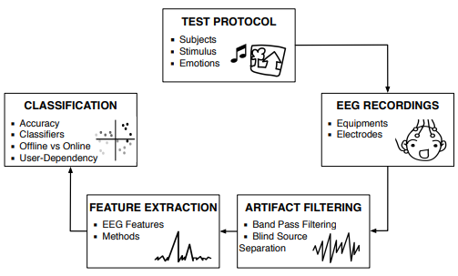
Emotion Recognition from EEG

Slide 23
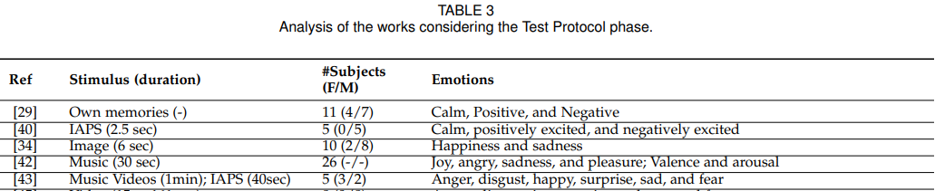
Test Protocol
Subject
- Consider the number of participants and the gender ratio for accuracy.
Stimuli
- Subject_elicitation or Event_elicitation
- Define ground truth of the emotional state(duration of emotion..)
Emotions
- identify basic emotions

Slide 24
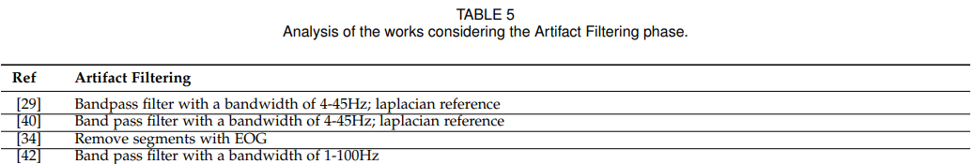
Test Protocol
Artifact Filtering
- Blind Source Separation (BSS)
- Independent Component Analysis (ICA)
- Common Average Reference (CAR)
- Laplacian
- Average Mean Reference (AMR)
- Bandpass Filter

Slide 25
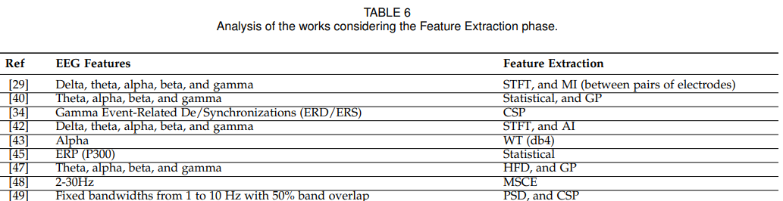
Test Protocol
Feature Extraction
- select which bands to use
- use multiple method to extract features, although in the end only one was selected
as the best one

Slide 26
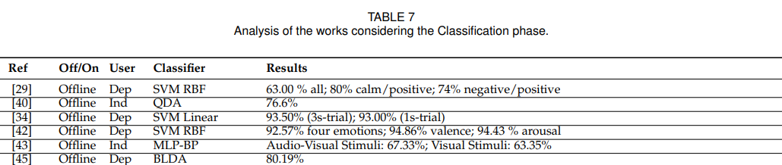
Test Protocol
Classification
- A majority of the works applied more than one classifier, and select only one for the
final configuration of recognizer.
- EEG signals are always changing its nature with time. -> lead to classification models
to not reflect the changes that have already occurred to the EEG signals.
- User-dependent Or Independent

Slide 27
Conclusion
Two perspectives:
1. a set of recommendations to avoid common pitfalls
2. steps of the process of recognizing emotions from EEG signals
This paper propose best practice recommendations to help researchers produce well-validated and high-quality works.

